Slide 1
Google Summer of Code
Artificial Intelligence Club Habib University, Karachi
Tahir Ramzan
GSoC Scholar 2015 and 2016
GCI Mentor 2018 and 2019

Slide 2
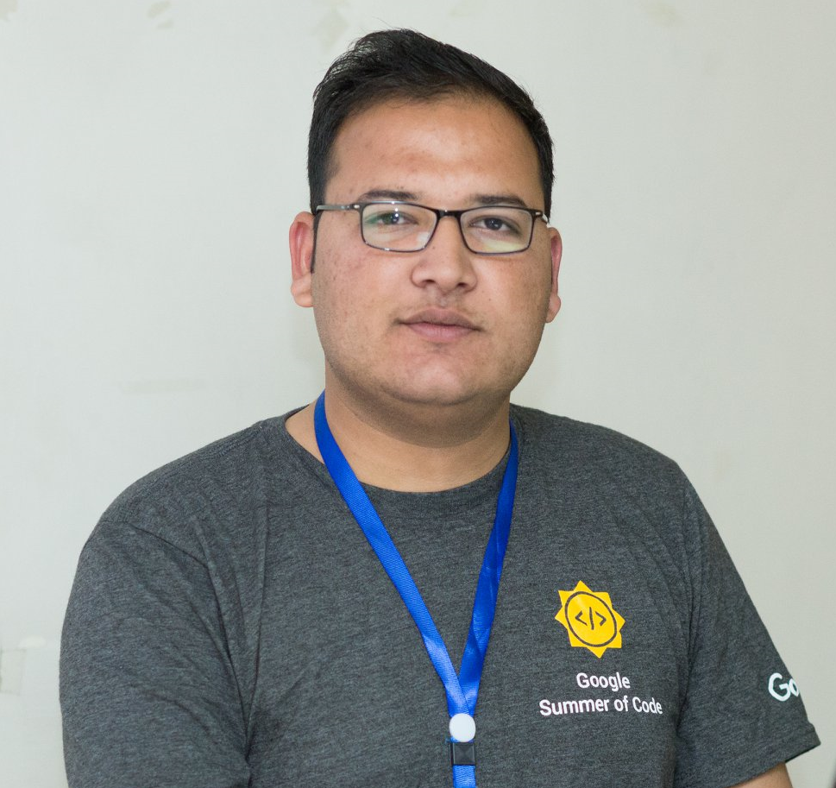
About Tahir Ramzan
-> Google Summer of Code Student 2015 (CiviCRM) -> Google Summer of Code Student 2016 (ModSec) -> Google Code-in Mentor 2018 (PostgreSQL) -> Google Code-in Mentor 2019 (TensorFlow) -> Google Android Students Club Facilitator & Organizer 2015

Slide 3
What is Google Summer of Code?
Google Summer of Code is a program designed to encourage students’ participation in opensource software development. Students work with an opensource organization on a 3-month programming project.

Slide 4
What are the Perks?
-> Google tag for your resume
-> Real-world software development skills
-> Professional connections worldwide
-> One time referral for interview at Google
-> Gateway to other opportunities and events
-> 3000USD Stipend for Pakistani Participants

Slide 5
Eligibility
Any student aged 18+

Slide 6
Requirements
Interest in learning and research

Slide 7
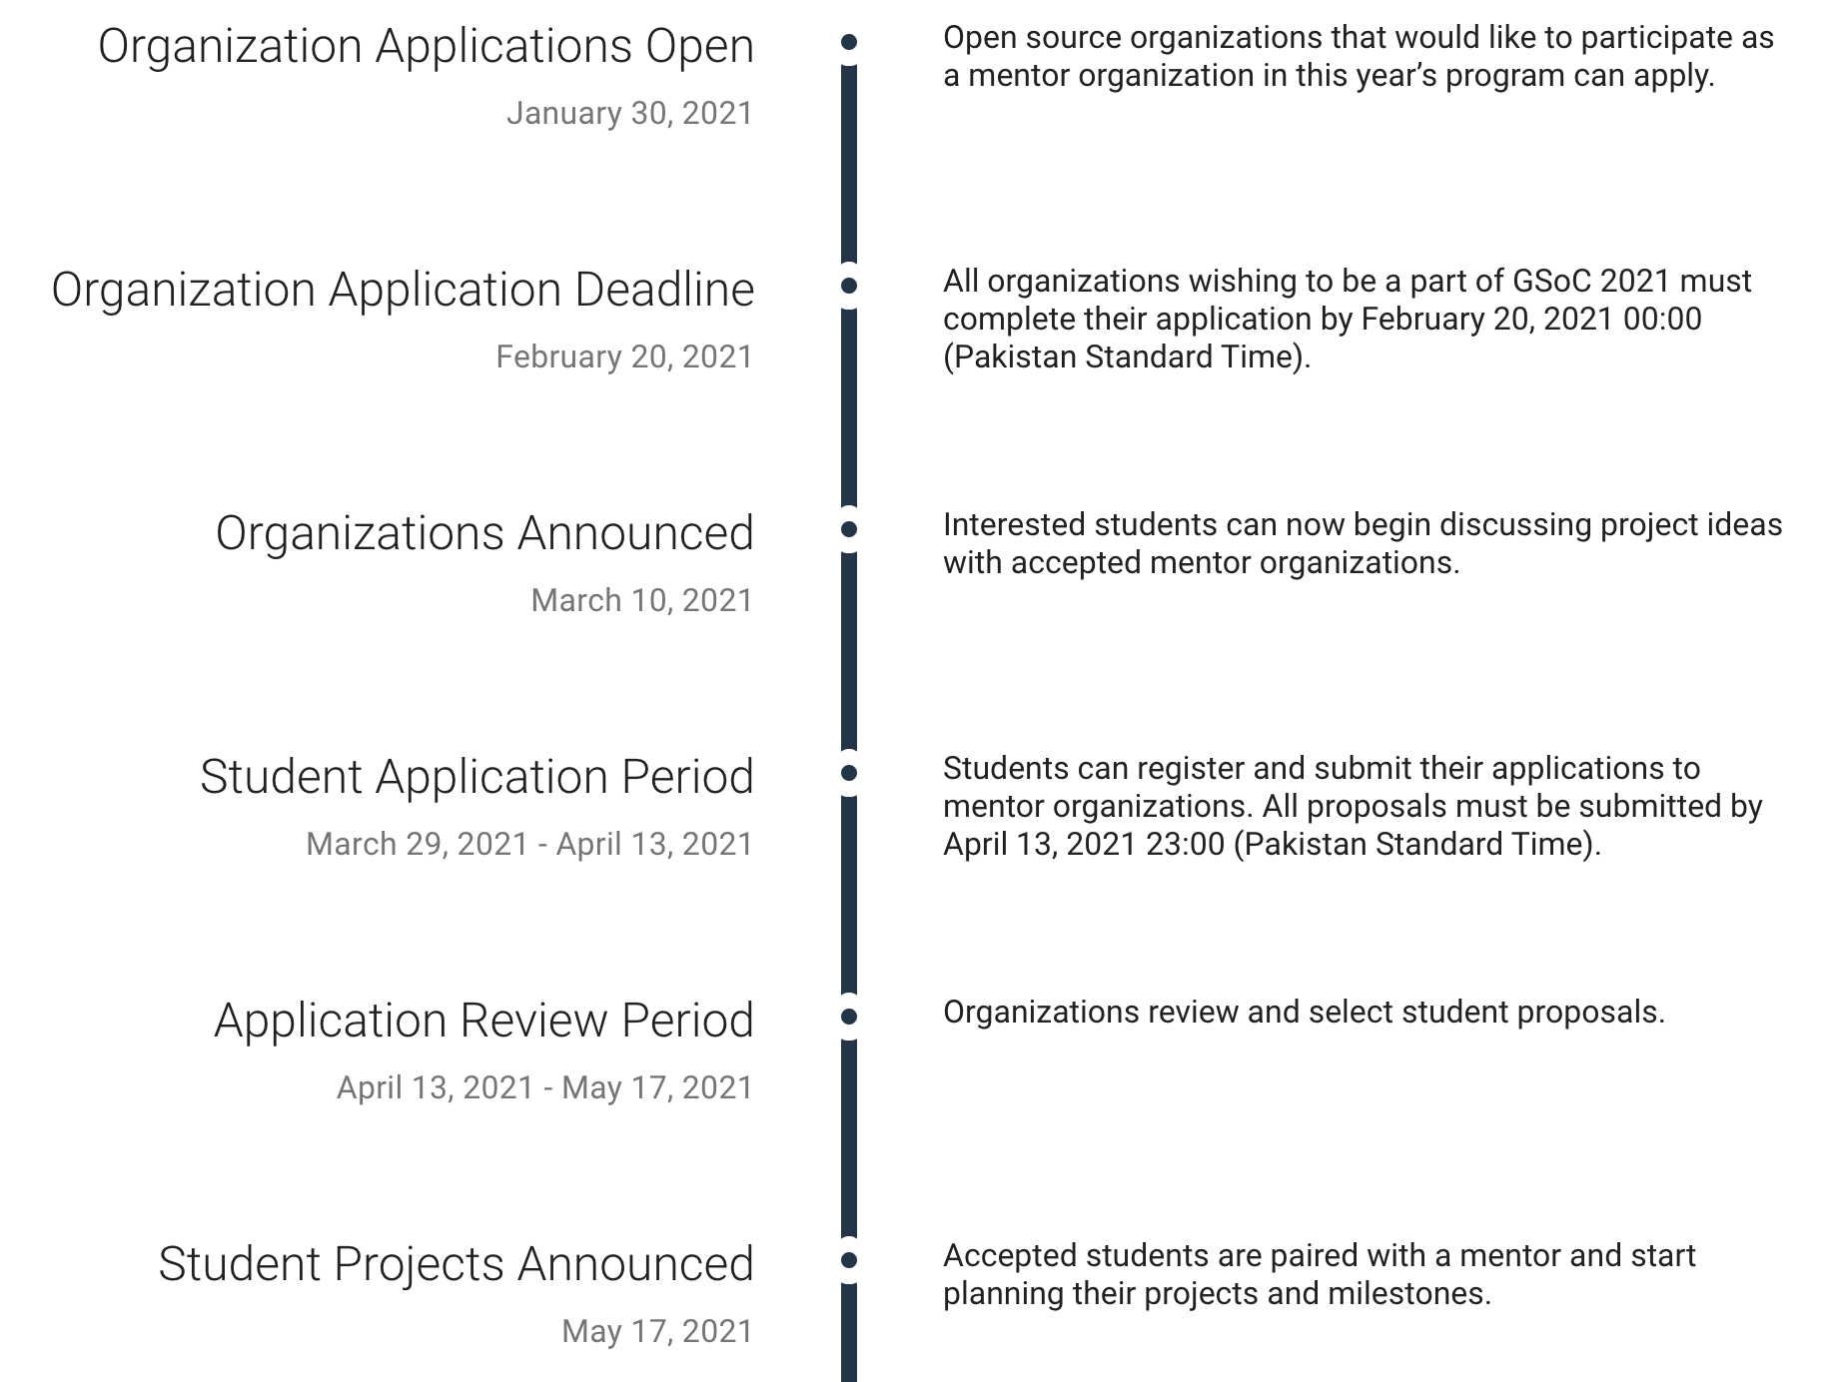
Timeline

Slide 8
Application Procedure
-> Choose your project and organization (upto 3)
-> Contribute to organization
(fix typos, minor bugs, add features)
-> Write proposal for chosen project
-> Get proposal reviewed by the mentors
-> Submit proposal, and proof of enrollment

Slide 9

First Step
go through procedure, and experiences

Slide 10

Second Step
Learn from experiences of past GSoCers

Slide 11
Third: Getting Started
https://summerofcode.withgoogle.com/
-> Review timeline
-> Read guides and FAQ
-> Shortlist organizations and projects

Slide 12
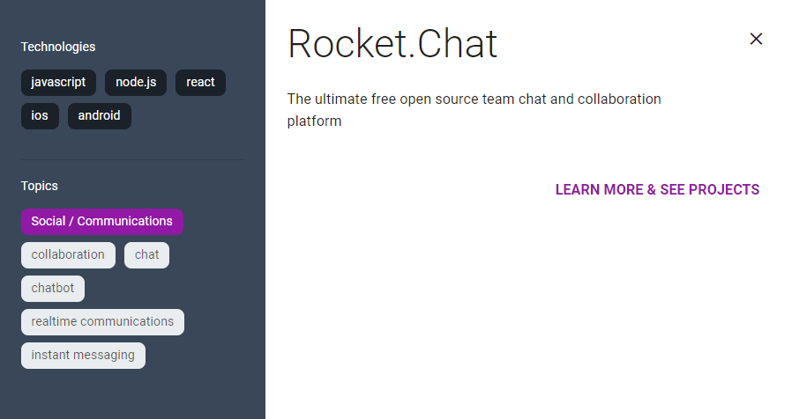

Slide 13
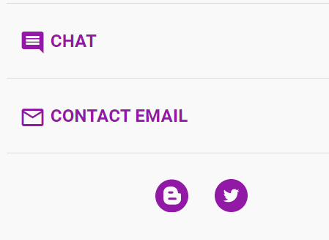
Fourth Step
-> Utilize all contact options
-> Email mentors to show interest

Slide 14
Fifth Step
-> Read chats and forums
-> Download, install, and explore softwares

Slide 15
Sixth Step
-> Follow the guidelines
-> Focus on research, originality and creativity

Slide 16

Seventh Step
Read and ask questions

Slide 17

Eighth Step
Fix typos, bugs and add features

Slide 18

Final Step
Help the community

Slide 19
Free and Opensource Software
-> GSoC as Open -> GSoC as Inclusive -> GSoC as Opportunity

Slide 20
What is Opensource?
It is a philosophy, or methodology that promotes free redistribution and access to a product’s design or ideas and implementation details. -> Open as in free -> Open as in access -> Open as in use and reuse -> Open as in distribute and redistribute

Slide 21
What is Opensource?
-> The freedom to use the software and have access to the source code. -> The freedom to modify the software. -> The freedom to redistribute the software. -> The freedom to ensure that all modifications must be redistributable.

Slide 22
My Journey
-> GSoC 2013 (Failure) -> GSoC 2014 (Rejected) -> GSoC 2015 (Accepted ☺) -> GSoC 2016 (Shortlisted by 02 organizations☺)

Slide 23
Questions
1. What is Google Summer of Code?
2. What is an Organization in GSoC?
3. What is an Umbrella Organization?
4. What is a Project?
5. What is a Project Idea?
6. What is a Project Proposal?
7. Who are the Mentors?
8. Who are the Organization Administrators?
9. How to Participate?
10. How to select an organization?

Slide 24
Questions
11. How to connect to an organization?
12. How to communicate to a mentor?
13. How to collaborate with the community?
14. Which idea you can propose?
15. Which skills are needed?
16. How to write a proposal?
17. When to start working?
18. What is the role of GitHub profile?
19. What is the role of LinkedIn profile?
20. What are the perks of GSoC student?

Slide 25
Qualities of GSoC Aspirants
-> Logic over Syntax
-> Understanding of Code
-> Reading of Documentation
-> Fast Learners and Quick Adopter
-> Comfortable with Linux Environment
-> Independent Thinkers and Team Players
-> Used to with Distributed Version Control System
-> Good Foundation of Data Structures and Algorithms
-> Confidence, Communication, Collaboration and Contribution

Slide 26
A kind message before you apply to Google Summer of Code -> It is not an internship. -> It will not guarantee you a job at Google. -> It will not guarantee you a 'FAANG' interview. -> It is not the Nobel, Oscars, and Olympics of the competitive and speed programming world.

Slide 27
-> When you spam the IRC, Google Groups, Slack, forums, and email lists of open-source organizations, without doing any research, without even understanding what the project is about, you make Pakistanis look sick.

Slide 28
-> If you are deciding what field to go into, web dev, app dev, AI/ML, etc., based on the number of slots an organization has, you are doing it all wrong. Think about it, do you want some competition to determine what you do for the next few decades of your life?

Slide 29
-> There are no shortcuts, and you cannot game the system. The maintainers of projects have been contributing longer than you have been alive; they know every trick in the book.

Slide 30
-> Taking a public survey of how other 'GSoCers' got selected will not help you, but it might even be counterproductive. Do your work from scratch on your own.

Slide 31
-> Don't copy, paste, and plagiarize. It is a sure way of ruining your reputation. Please learn; what is a citation? And how to quote your sources.

Slide 32
-> Being polite will help, but heaping excessive praise is a red flag; please don't do that.

Slide 33
Thank You! Yours Sincerely, A Pakistani GSoCer who cracked it twice in a row https://tahir.pro/

